Slide 1


Student Details
Name: Satwika Varshini mungara
college name: SRI VASAVI ENGINEERING COLLEGE
COLLEGE STATE: ANDHRA PRADESH
INTERNSHIP DOMAIN: ARTIFICIAL INTELLIGENCE / JUNE 09 – JULY 07
Email id: mungarasatwika@gmail.com

Slide 2
PROJECT TITLE/Problem Statement
Employees Burnout Analysis and Prediction
World Mental Health Day is celebrated on October 10 each year. The objective of this day is to raise an awareness about mental health issues around the world and mobilise efforts in support of mental health. According to an anonymous survey, about 450 million people live with mental disorders that can be one of the primary causes of poor health and disability worldwide. You are a Machine Learning engineer in a company. You are given a task to understand and observe the mental health of all the employees in your company. Therefore, you are required to predict the burn out rate of employees based on the provided features thus helping the company to take appropriate measures for their employees.

Slide 3
AGENDA
Accurate prediction provides a number of important benefits for research and decision-making. Occupational burnout is intertwined with individual, cultural, and social factors, the resolution of which requires methods that can deal with large amounts of data.
The application of such methods capable of dealing with large datasets is a relatively novel research area in social science. For this purpose, this article presents insights into machine learning methods, mainly related to prediction tasks.
A brief review of these techniques in burnout domain was applied. It is shown that the choice of a method depends on the presence of certain dependent variables. This paper also presents a comparison between novel and traditional approaches, which shows that the appropriateness of a technique depends on the aim of the research.

Slide 4
AGENDA
The theoretical and practical implications of using machine learning methods in this context is also presented in the paper. It is found that a gap in the study of burnout exists which requires the attention of social work researchers. Through machine learning techniques, new theoretical models of burnout can be created.
These algorithms can also provide new approaches to create data-driven interventions. Burnout monitoring systems supported by machine-learning algorithms can also be used in recruitment processes and to supervise employees. Applying machine learning methods in reducing burnout can also provide socio-economic benefits such as help to reduce employee turnover and improve general working conditions.

Slide 5
PROJECT OVERVIEW
Employee burnout often manifests as an increasing lack of enthusiasm and engagement that builds over time in response to job dissatisfaction. The consequences of burnout may include increased employee absence, lower productivity, and higher turnover, all of which can affect a company's bottom line.
Data shows a large issue a lot of companies are facing is employee burnout. As employees burn out they become much less productive. It is estimated that employee burnout costs companies between $125 billion and $195 billion each year. By preventing burnout a company can save money and increase the morale of their employees. This project's goal is to look at what factors may influence employee burnout and possibly to predict it.

Slide 6
WHO ARE THE END USERS of this project?
End users of this project are any software or hardware companies that having many number of employees as manpower.
Any multinational companies and product based companies and service based companies are the end users of this project which is named as Employees Burnout Analysis and Prediction.
It's critical to recognize these red flags early because employee burnout affects not only your bottom line but your team's overall well-being. Burnout can cause lower confidence levels, decreased engagement and loyalty and lackluster customer service. It can also affect your ability to scale your business quickly.

Slide 7
YOUR SOLUTION AND ITS VALUE PROPOSITION
MY SOLUTIONS:
Evaluate your options. Discuss specific concerns with your supervisor.
Seek support. Whether you reach out to co-workers, friends or loved ones, support and collaboration might help you cope.
Try a relaxing activity.
Get some exercise.
Get some sleep.
Mindfulness.

Slide 8
YOUR SOLUTION AND ITS VALUE PROPOSITION
EMPLOYEE VALUE PROPOSITION:
Scope out what your company currently offers.
Collate feedback from employees (past and present)
Identify and define the key points to include in the EVP.
Draft your EVP(Employee Value Proposition).
Compare and evaluate your EVP.
Communicate your EVP via relevant channels.
Assess responses to your EVP.

Slide 9
How did you customize the project and make it your own
Reprioritize. Stop what you're doing and make a list of your work demands.
Refresh your skills. There may be an easier way to accomplish your tasks.
Take your breaks.
Connect with others.
Make life more than work.
The solution to burnout isn't to ask already stressed employees to 'fix themselves'. Instead, it's up to employers to help build strategies at the organizational and team level, while not ignoring factors at the individual level, either. One powerful option is to put in place an employee mentoring system.

Slide 10
MODELLING
Burnout Theories: These theories are Conservation of Resources Theory, Demands-Resources Model, Social Cognitive Theory, Existential Perspective and Developmental Process Model.
The first, unsurprisingly, is that the level and duration of stress an individual experiences is an accurate predictor of burnout. The higher the level of stress experienced and the longer they are stressed, the more likely an individual is to burnout
Burnout is a prolonged response to chronic emotional and interpersonal stressors on the job. It is defined by the three dimensions of exhaustion, cynicism, and inefficacy
The model of workplace stress used for this Work Positive programme is a mixture of: The Demand/Control /Support Model (Karasek and Theorell) The Effort Reward Imbalance Model (Siegrist)

Slide 11
Results
BACKGROUND
Data shows a large issue a lot of companies are facing is employee burnout. As employees burn out they become much less productive. It is estimated that employee burnout costs companies between $125 billion and $195 billion each year. By preventing burnout a company can save money and increase the morale of their employees. This project's goal is to look at what factors may influence employee burnout and possibly to predict it.
DATA
The data was derived from a data set from Kaggle. The data set contains responses of a from employees across different industries. Some of the key data points are: date of joining, gender, company type (service or product), work from home availability, resource allocation (amount of resources and employee is allocated to work such as working hours), employee tenure designation, and finally a mental fatigue score. This project looks at which one of these factors determine the mental fatigue score.

Slide 12
RESULTS
PREDICTIVE DATA
When analyzing the data I decided to go by P-value and AIC to determine what data would be most predictive when analyzing employee burnout. The first piece of data used with a p-value of <.001 is work from home availability.
The second piece of data with a p-value of <.001 was resource allocation.
And finally the third piece of data with a p-value that ranges by factor is tenure designation.

Slide 13
RESULTS
Multiple Linear Regression Analysis:
In order to for the model to remain simple to the burn out fatigue score was not transformed. When attempting to transform the data the multiple R squared was mostly unaffected. In total, the model had a multiple R squared of 66%. This shows that employee burnout can be somewhat predicted. Not having the ability to work from home, having more work to do, and more responsibility will increase an employee's mental fatigue.

Slide 14
RESULTS
Recommendation and Testing:
The recommendations made for companies attempting to lower mental fatigue score are as follows:
Strongly consider work from home options
Consider hiring more employees in roles with high resource allocation
Promote work/life balance amongst senior employees
Success can be determined by resurveying the employees in 6 months to test if mental fatigue score is lowered.

Slide 15
RESULTS
Future Work:
In the future to help improve the model I would like to look at survey results from one specific company this way it will make the dependent variables more standard. For example an employee designation of 3 in company X may look different in company Y. I believe this will make the model more accurate. However, if the survey were to remain broad it may be beneficial to notate the industry the employee works in. This will also help standardize the data as well as give a better idea as to how the date affects mental fatigue (for example an accountant will probably answer differently in February vs November).

Slide 16
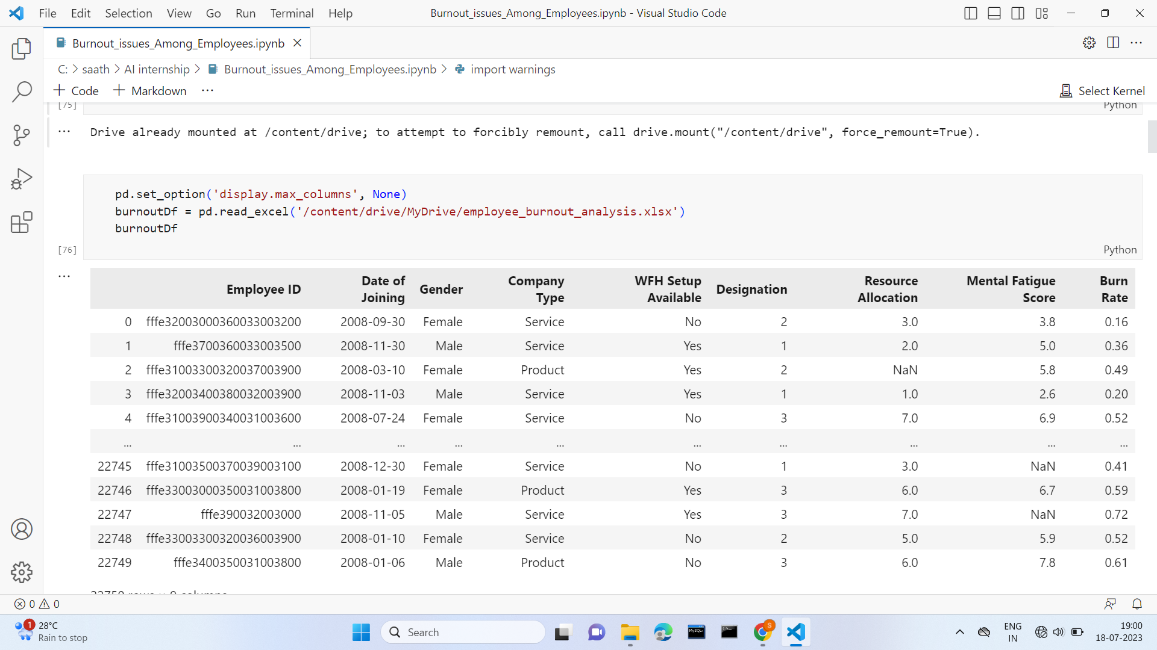
Results

Slide 17
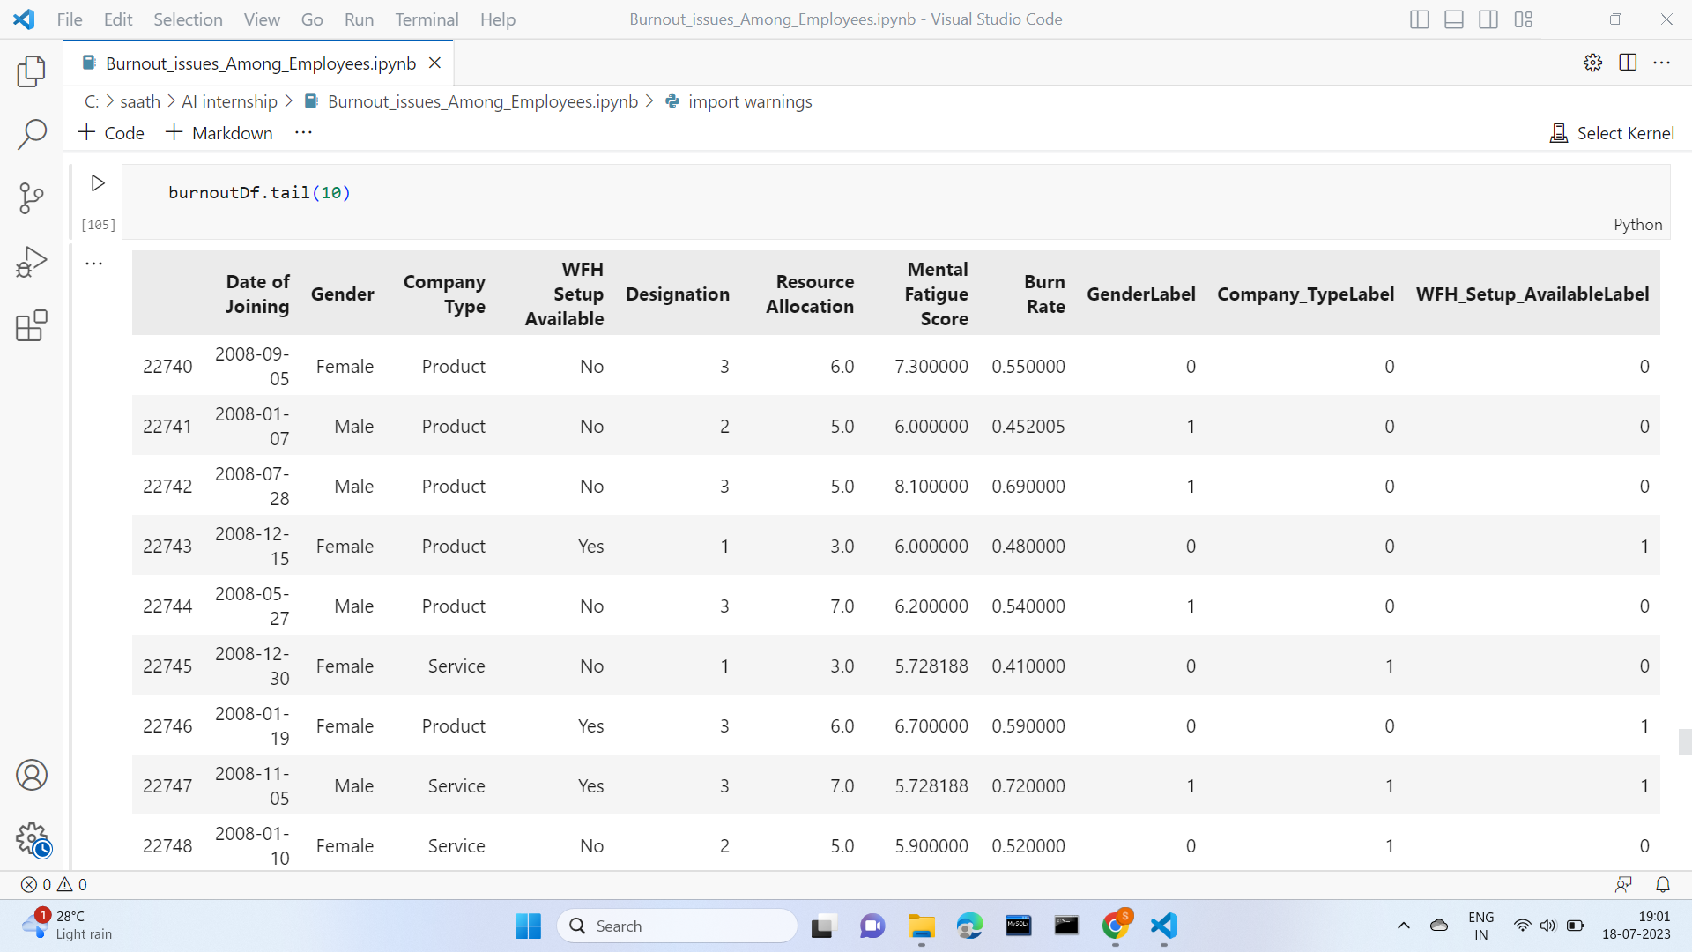
results

Slide 18
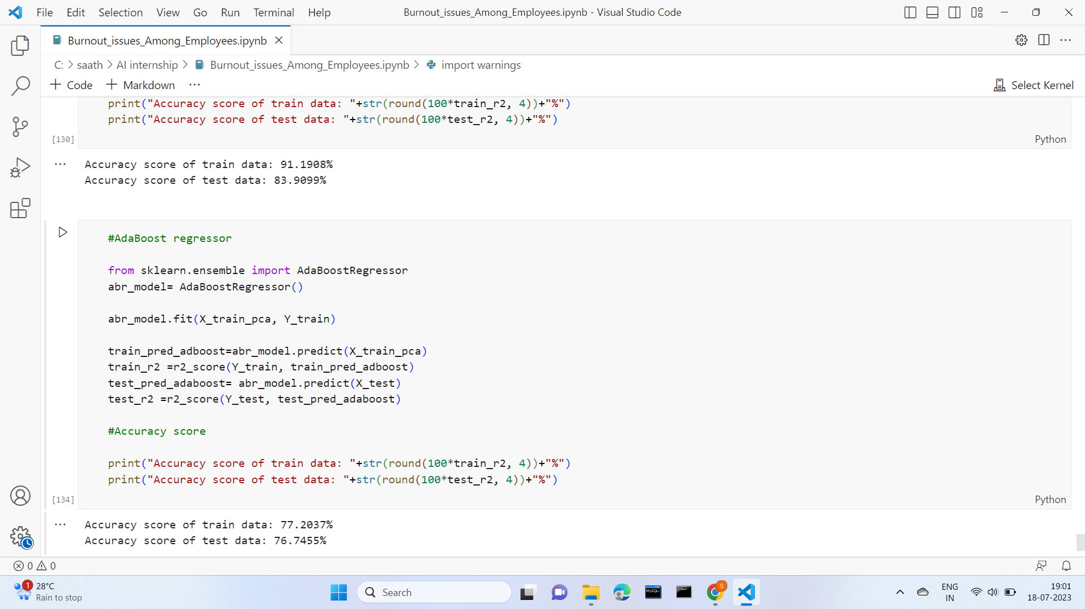
results

Slide 19
links
WEBSITES Visited: https://nycdatascience.com/blog/student-works/tracking-data-and-predicting-employee-burnout/
https://link.springer.com/article/10.1007/s10560-020-00733-w
https://www.hackerearth.com/practice/machine-learning/machine-learning-algorithms/beginners-guide-regression-analysis-plot-interpretations/practice-problems/machine-learning/predict-the-employee-burn-out-rate-7-6340b4e3/
LINKEDIN: https://www.linkedin.com/in/satwika-varshini-m-57284822b/
GITHUB Project Code: https://github.com/satwikavarshinimungara/AI-APSCHE-Internship/blob/main/Burnout_issues_Among_Employees.ipynb

